Slide 1
STORY 3
File created on: 10/31/2023 9:11:45 AM

Slide 2
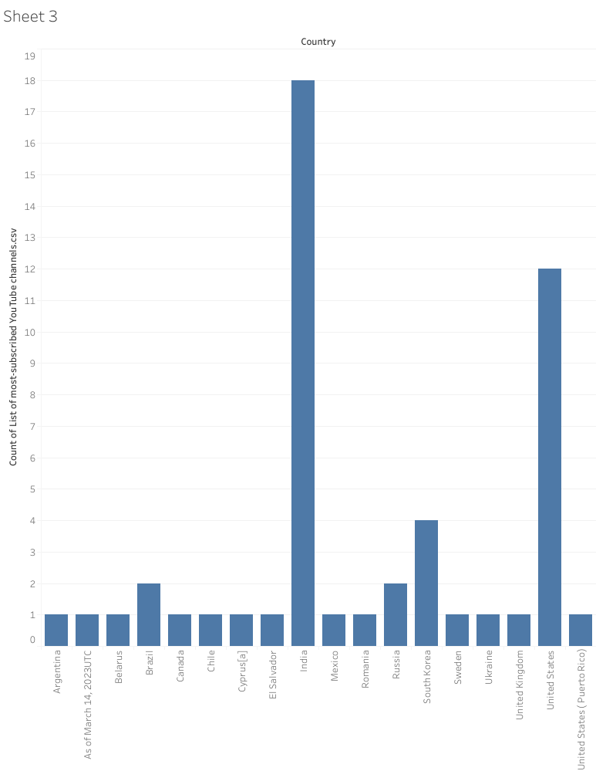

Slide 3
